Slide 1
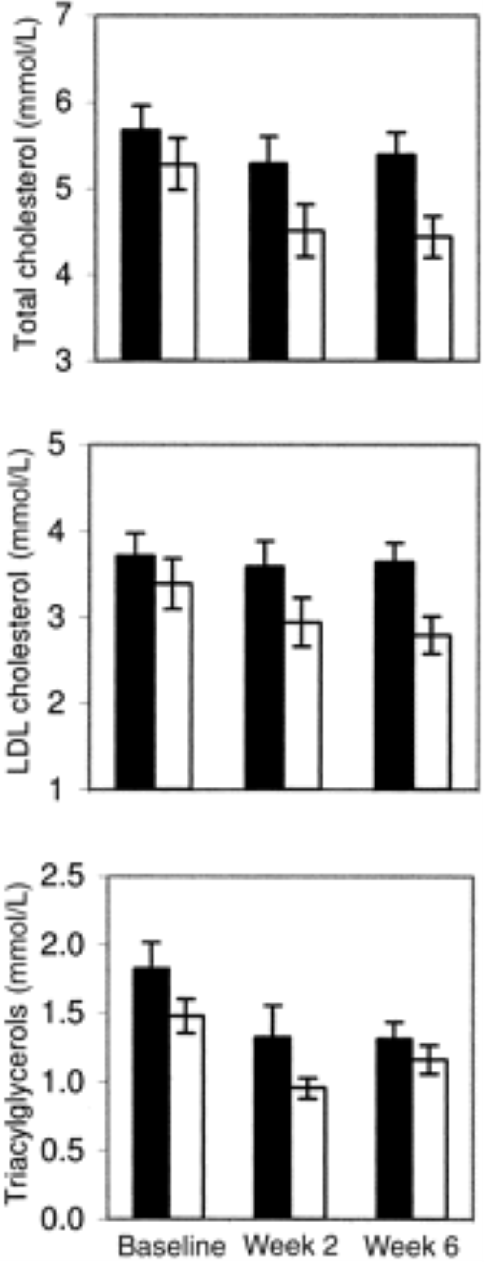
From: Ketogenic low-carbohydrate diets have no metabolic advantage over nonketogenic low-carbohydrate diets
Am J Clin Nutr. 2006;83(5):1055-1061. doi:10.1093/ajcn/83.5.1055
Am J Clin Nutr | © 2006 American Society for Clinical Nutrition
Notes:
FIGURE 3. Mean (±SE) total cholesterol, LDL-cholesterol, and triacylglycerol concentrations in the ketogenic low-carbohydrate (KLC, ▪; n = 9) and nonketogenic low-carbohydrate (NLC, □; n = 10) diet groups during the 6-wk feeding trial. Time effects were significant (P < 0.001, P = 0.027, and P = 0.003, respectively), and group × time interactions were not significant (P > 0.05, repeated-measures ANOVA).

